Slide 1
Pricing our mountain for what it offers
BIG MOUNTAIN RESORT
Executive briefing · November 2026
Notes:
This briefing answers two questions for the leadership team: what ticket price Big Mountain’s facilities can support, and which facility changes would raise revenue or cut costs. The short answer: we are charging less than our facilities justify.

Slide 2
Our price isn’t based on our facilities
PROBLEM IDENTIFICATION
$81
$1.54M
350,000
Current adult weekend ticket price, set as a premium over the market average
Added operating cost each season from the new chair lift
Visitors expected each season, at about five day tickets per visitor
The question: what ticket price do our facilities support, and which changes would raise revenue or cut costs?
Big Mountain Resort · Montana
Notes:
Big Mountain charges $81 for an adult weekend ticket. That price was set by charging a premium over the average for resorts in our market, not by looking at which facilities customers actually value. At the same time, the new chair lift adds $1.54 million a season to operating costs. With about 350,000 visitors each buying five tickets, we wanted to know two things: what price our facilities support, and which changes would raise revenue or cut costs.

Slide 3
Raise the price gradually toward $95.87
RECOMMENDATION AND KEY FINDINGS
+$14.87 room to grow
Approve Scenario 2
Our facilities support $95.87 against today’s $81. Raise it in steps and track ticket sales after each one.
One more run, 150 ft more vertical drop and an extra chair: +$1.99 a ticket, about $3.47M a season.
Chair lift: $0.88 a ticket
Trial one run closure
The $1.54M operating cost spread over 1.75M tickets is easily covered by a small price rise.
Closing one little-used run shows no loss in supported price. Test it for a season before closing more.
Modelled on 276 US ski resorts · revenue assumes 350,000 visitors × 5 tickets
Notes:
Our recommendation comes first so you have it up front. The model says our facilities support a ticket price of about $95.87, almost $15 above today’s $81. We recommend raising the price in steps rather than all at once, because the model can’t see how our own customers would react. Second, approve Scenario 2: it adds about $1.99 a ticket, roughly $3.47 million a season, more than double the chair lift’s cost. Third, the chair lift works out at only 88 cents a ticket. Finally, closing one little-used run costs nothing in predicted price, so it is worth trialling for a season.

Slide 4
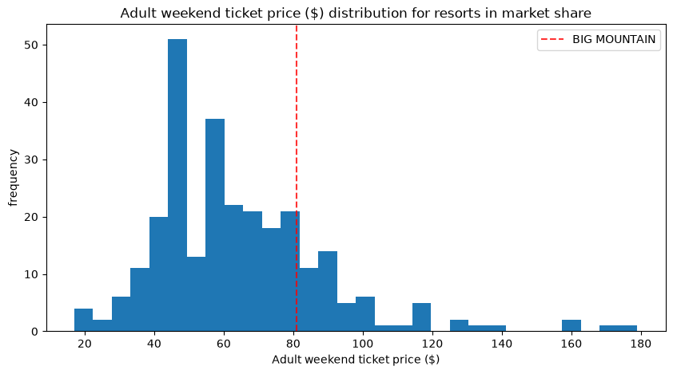
Our facilities support a price of $95.87
MODELING RESULTS · 1 OF 4
Today
Modelled
$81
$95.87
The gap is wider than the model’s typical error of $10.39, so a price rise is supported.
Big Mountain ranks near the top on vertical drop, snowmaking, chairs, fast quads, runs and skiable area.
Ticket prices across all resorts; the red line is Big Mountain today
Random forest refit on all 276 other resorts · cross-validated average error $10.39
Notes:
We already charge more than most resorts, as the chart shows. But when the model compares our facilities with everyone else’s, it says we could support about $95.87. That is almost $15 more than today, and well beyond the model’s typical error of about $10. The reason is simple: we rank near the top on the facilities customers pay for, including vertical drop, snowmaking, fast quads and runs.

Slide 5
Random forest was the most accurate model
MODELING RESULTS · 2 OF 4
Approach | Avg error, cross-val | Avg error, test
Guess the average price | — | $19.14
Linear regression | $10.50 | $11.79
Random forest (chosen) | $9.64 | $9.54
What drives price: four features dominate
26%
Fast quad lifts
Number of runs
25%
Snowmaking area
11%
Average error = how many dollars a predicted price is off, on average. The random forest was about $1 more accurate, and its test result matched its estimate.
Vertical drop
9%
Skiable terrain
3%
Total chairs
2%
Projected days open
2%
Share of state days open
2%
Share of the model’s importance, top 8 of 32 features
Trained on 193 resorts, tested on 83 · 5-fold cross-validation
Notes:
We tested three approaches. Simply guessing the average price for every resort was off by about $19. A linear regression cut that to around $11. A random forest did best, off by about $9.50 on average, and it held up on resorts it had never seen. The chart on the right shows what the model relies on most: fast quad lifts, number of runs, snowmaking area and vertical drop. Those are exactly the areas where Big Mountain is strong.

Slide 6
Scenario 2 is the best option: +$3.47M a season
MODELING RESULTS · 3 OF 4
Scenario | Price change | Season revenue
1. Close up to 10 of the least-used runs | $0 to −$1.81 | $0 to −$3.2M
2. Add a run, 150 ft of vertical drop and a chair | +$1.99 | +$3.47M
3. Scenario 2 plus 2 acres of snowmaking | +$1.99 | no extra gain
4. Longest run +0.2 miles, 4 acres of snowmaking | $0 | no change
Scenario 2’s extra $3.47M a season is more than double the new chair lift’s $1.54M operating cost.
Revenue = price change × 350,000 visitors × 5 tickets
Notes:
We tested four options by changing Big Mountain’s facilities and asking the model what price they would support. Scenario 2, adding a run, increasing vertical drop by 150 feet and adding a chair lift, is the clear winner at about $1.99 more per ticket, or $3.47 million a season. Adding a little snowmaking on top of that, or lengthening the longest run, made no difference to the predicted price, so we don’t recommend spending on them. Run closures are on the next slide.

Slide 7
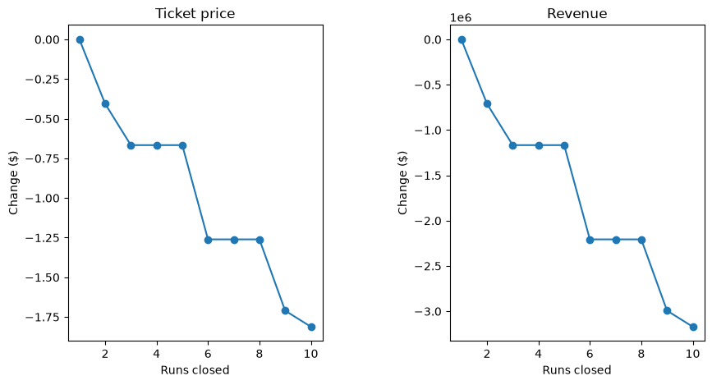
One run closure is free; more cut revenue
MODELING RESULTS · 4 OF 4
1 run: $0
No loss in supported price
2–5 runs
Up to −$0.67 a ticket, about −$1.2M a season
6+ runs
−$1.26 or more, at least −$2.2M a season
Scenario 1 · least-used runs closed first
Notes:
If we want to cut costs, closing one little-used run doesn’t reduce the price our facilities support at all. After that, losses come in steps: two to five closures cost up to about 67 cents a ticket, and six or more cost at least $1.26, over $2 million a season. We suggest trialling one closure for a season and tracking visitor numbers and sales before going further. Note that the model shows the effect on price only; we don’t yet have the operating cost savings from each run.

Slide 8
We’re undercharging for what we offer
SUMMARY AND CONCLUSION
Decisions for today
Next steps
Raise the ticket price in steps toward $95.87
Approve Scenario 2 (+$3.47M a season)
Trial closing one little-used run
Skip the extra snowmaking and longer run
Track sales and feedback after each price step
Gather visitor numbers and running costs per lift and run
Give analysts a simple tool to test their own scenarios
Big Mountain Resort · Guided Capstone Project
Notes:
To sum up: Big Mountain is charging less than its facilities justify. We’re asking for four decisions: raise the price gradually toward $95.87, approve Scenario 2, trial one run closure, and skip the snowmaking and longer-run options that added no value. Going forward, we’ll watch sales after each price step, collect visitor and cost data so the model can measure profit rather than just price, and put the model in a simple tool so analysts can test their own scenarios.

